Slide 1

Let’s Build a Deep Learning Network!!!!!

Slide 2
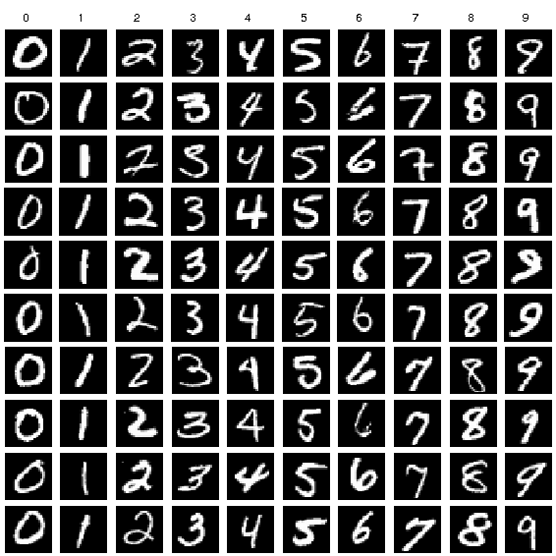
MNIST – The “Hello World” of Deep Learning

Slide 3
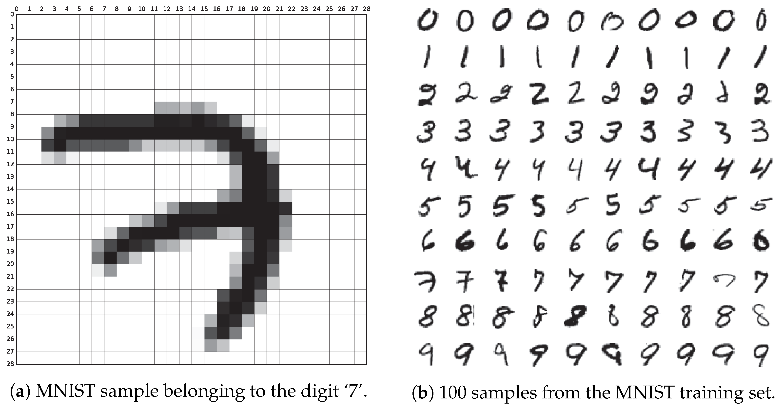
MNIST Dataset
Modified National Institute of Standards and Technology database
Contains 60,000 training examples of handwritten images + 10000 test examples
Used for training image classification
Each image is a 28X28 grey value pixel matrix

Slide 4
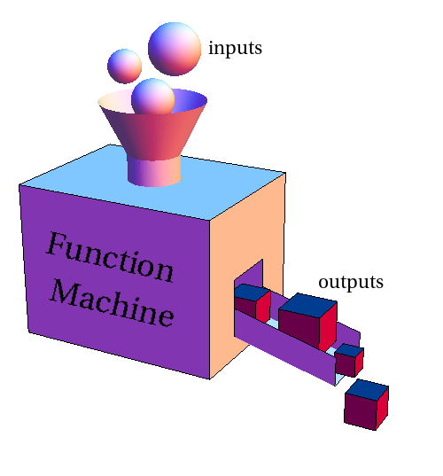

The goal – mapping an input image to a digit

Slide 5

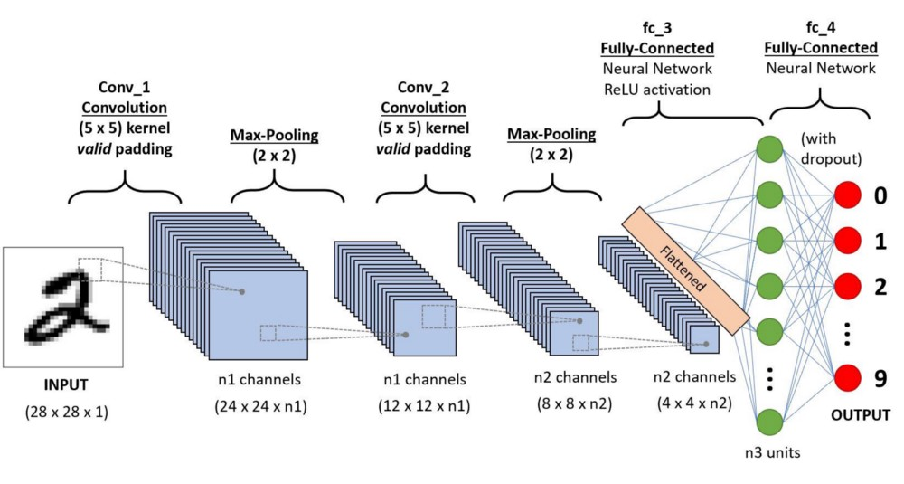

Slide 6

Small Steps – We’ll start with a simple network

Slide 7
Simple Neural Network
Layer
Layer
Layer
I
N
P
U
T
H
I
D
D
E
N
O
U
P
U
T

Slide 8
Stages
Load the data (training and test)
Prepare the input and output to be used in the Neural Network (NN)
Build the NN using some parameters (aka Hyperparameters)
Train the NN on the training data
Evaluate the performance on the test data

Slide 9
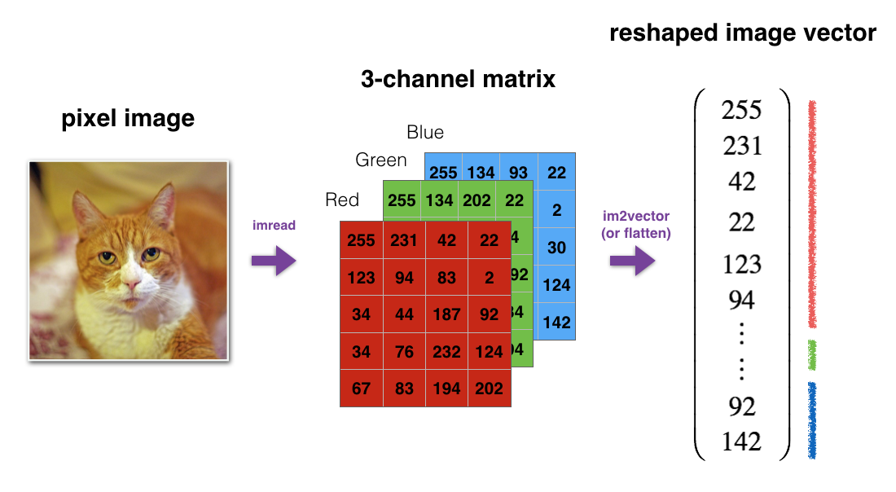
Preparing the input
Scale to: 0 – 1 range
1
0.905
0.165
.
.
.
.
.
.
.

Slide 10
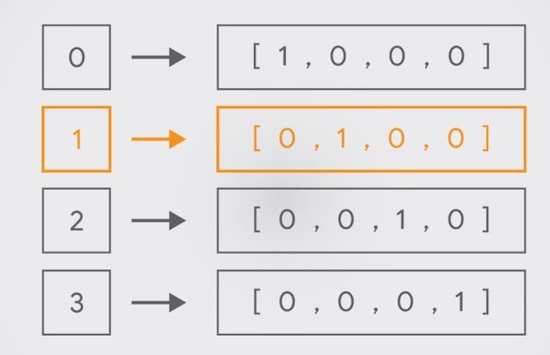
Preparing the output
One hot encoding

Slide 11
Simple Neural Network
Layer
Layer
Layer
I
N
P
U
T
H
I
D
D
E
N
O
U
P
U
T
0
0
0.12
0.14
0.55
.
.
.
0.25
0.45
0.66
.
.
.
0
0
1
0
0
0
0
0
0
0
784
features

Slide 12
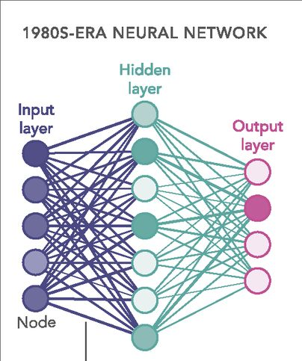


General principals
?
?
Initialize
parameters
Known output
input
Neural
Network
prediction
Stop
Adjust parameters

Slide 13
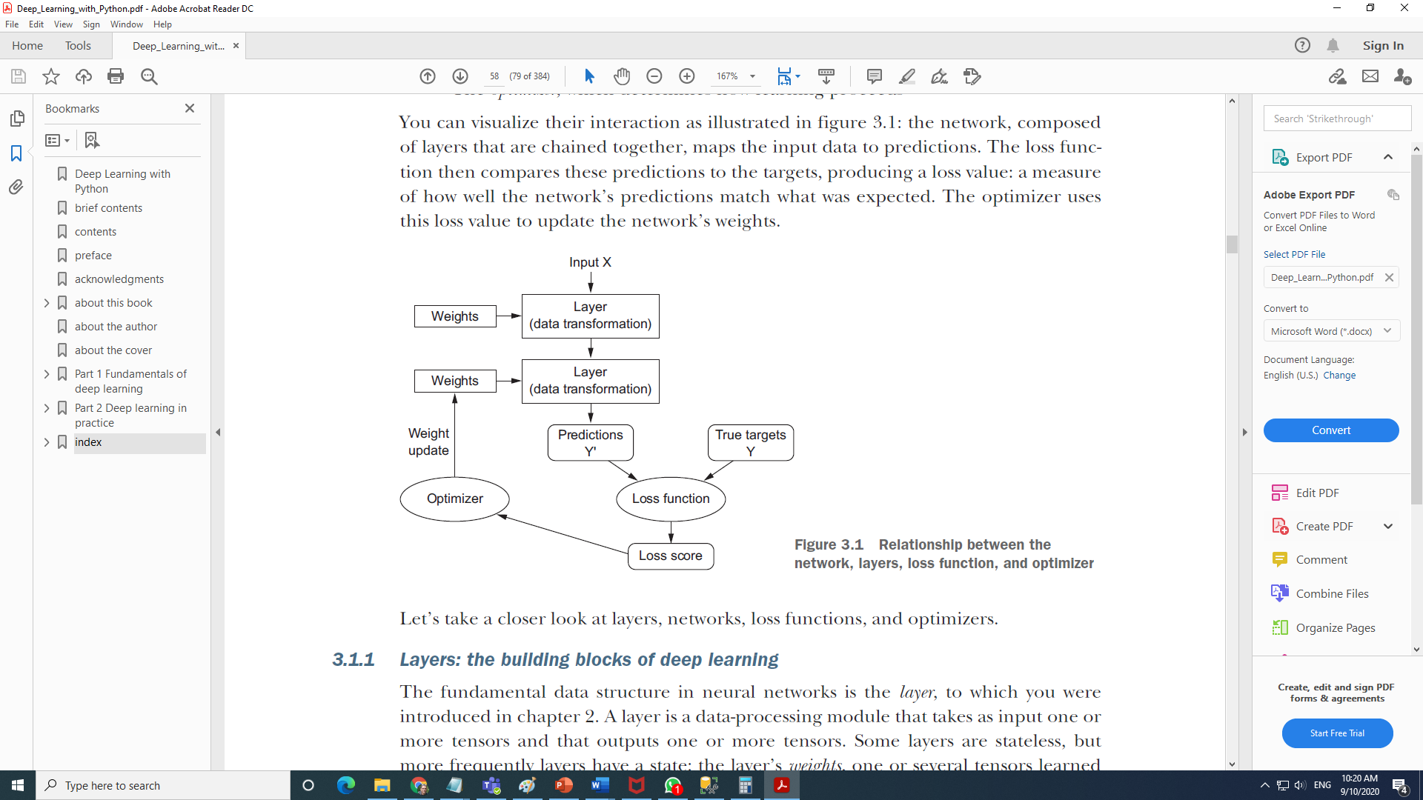
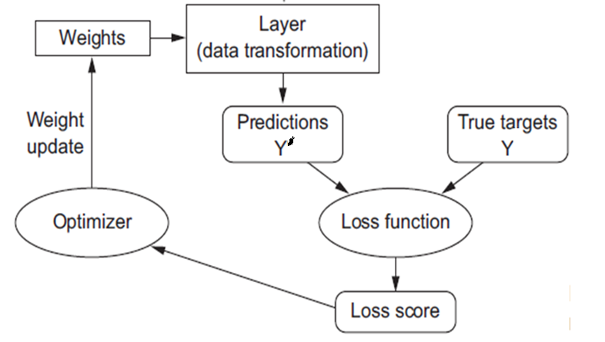
Back to the generic NN model
0
0
0.12
0.14
0.55
.
.
0
0
1
0
0
0
0
0
0
0
?
?

Slide 14
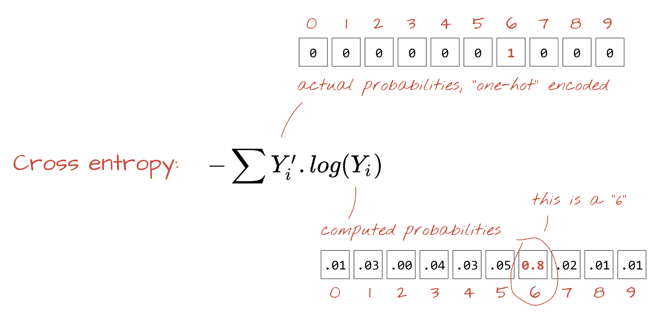
Choosing an output predictions and Loss function for multiclass classification
Softmax
Σ(p) = 1

Slide 15
Predictions and Loss
0
0
0.12
0.14
0.55
.
.
0
0
1
0
0
0
0
0
0
0
0.1
0.05
0.05
0.5
0.03
0.04
0.01
0.02
0.1
0.1
SoftMax
Σ(p) = 1
Cross
Entropy

Slide 16
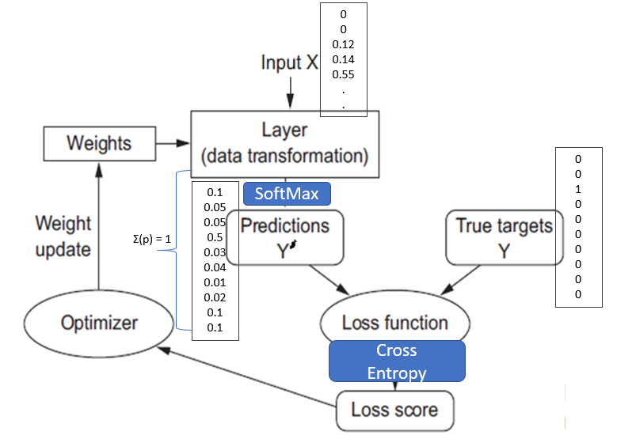
Optimize
The NN Model
Set Params
Set Hyper Params
Update the weights in a way that will reduce the Loss score

Slide 17
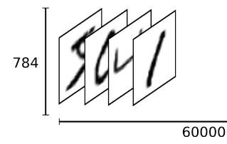
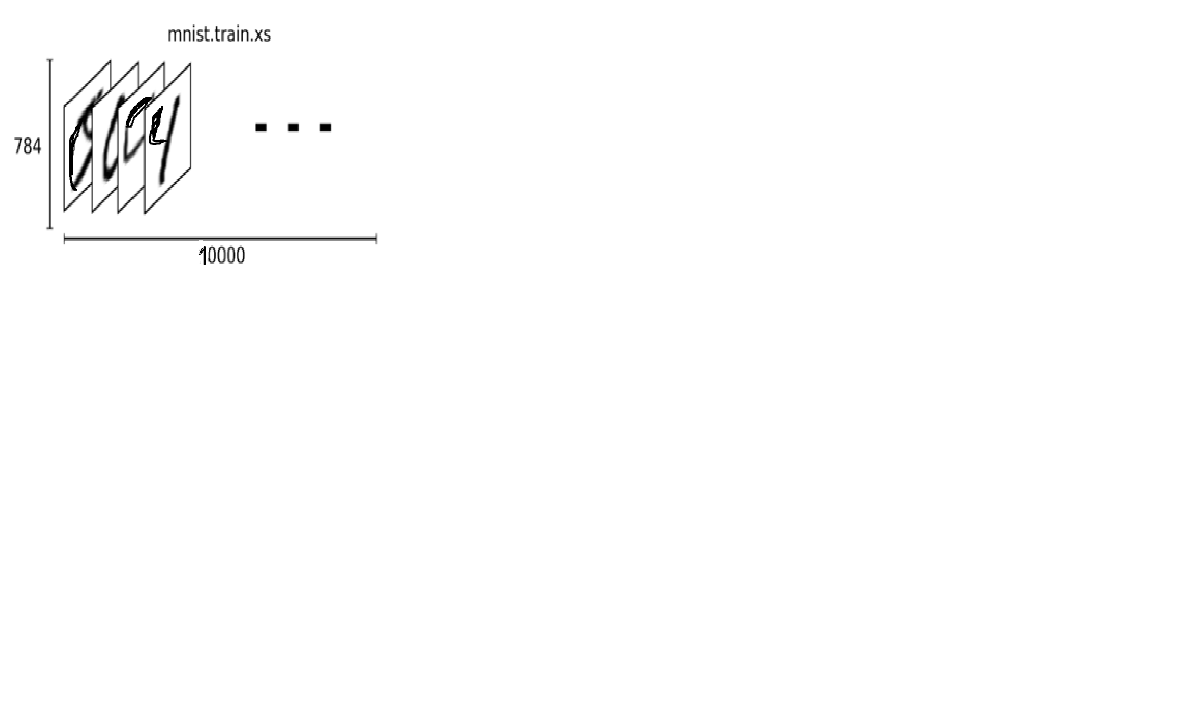
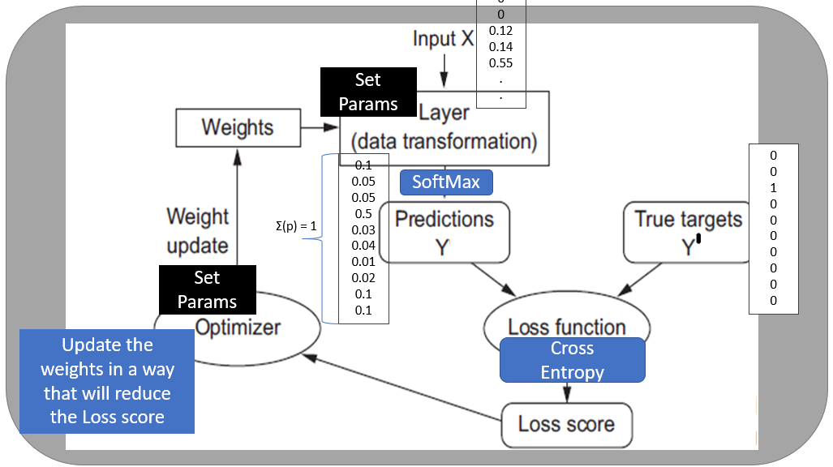
Training the model
Train
Test
10000
Train
Test
Y | P
5 | 5
6 | 4
4 | 4
1 | 1
Y | P
6 | 6
6 | 8
9 | 0
4 | 4
Success Criteria: Accuracy

Slide 18
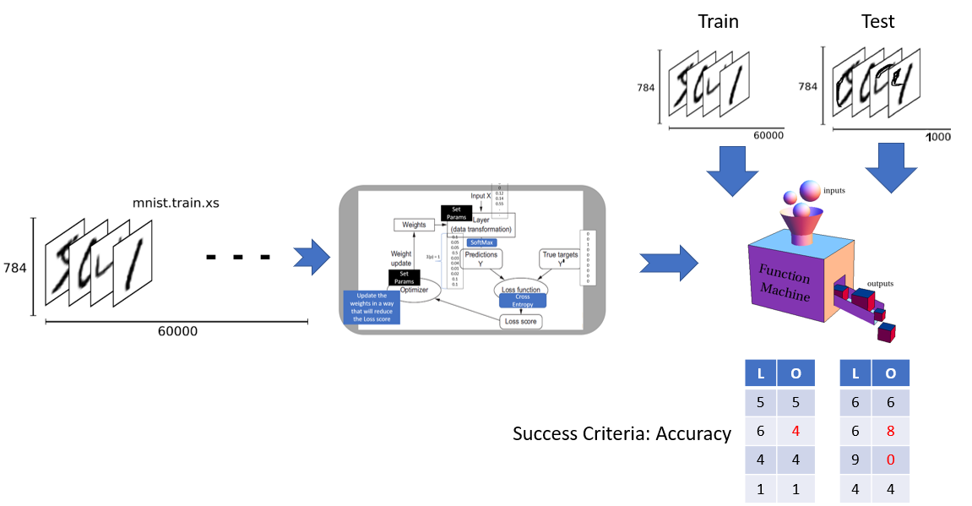
Epochs – Repeating the process
An epoch is a term used in machine learning and indicates the number of passes of the entire training dataset the machine learning algorithm has completed
Loss
Accuracy
Train
Loss
Accuracy
Test

Slide 19


KERAS
Main Developer : Francois Chollet
Designed to enable fast experimentation with deep neural networks
Open-source neural-network library written in Python
It is capable of running on top of TensorFlow, Microsoft Cognitive Toolkit, R, Theano, or PlaidML
User-friendly, modular, and extensible

Slide 20

Colaboratory, or “Colab” for short, is a product from Google Research.
Colab allows anybody to write and execute arbitrary python code through the browser, and is especially well suited to machine learning, data analysis and education.
Colab is a hosted Jupyter notebook service that requires no setup to use, while providing free access to computing resources including GPUs.

Slide 21
The code repository
https://github.com/fchollet/deep-learning-with-python-notebooks
https://github.com/fchollet/deep-learning-with-python-notebooks/blob/master/chapter02_mathematical-building-blocks.ipynb (second edition)

Slide 22
Class Ex
What is the train and test accuracy when:
#Epochs
 | 1 | 3 | 5 | 7 | 10
Training
Test
#Training samples
 | 1000 | 10000 | 30000 | 60000
Training
Test

